Slide 1



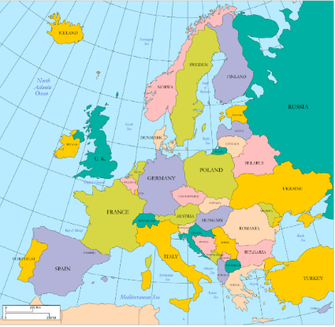
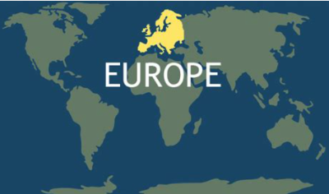
Europe
What should I already know?
Key vocabulary and definitions
How to locate countries using a map
and atlas.
The UK is a country in the continent of Europe.
The 4 compass points.
 | area of land
Europe | A continent in the Northern hemisphere.
UK (United Kingdom) | The four nations of England, Scotland, Wales and Republic of Ireland (Northern Ireland).
Physical features | Natural things that are not made by humans such as: hills, rivers, valleys, mountains and forests.
Human features | Things that have been built or influenced by humans such as: roads, bridges and houses.
Population | The number of people living in an area.
Latitude | An imaginary horizontal line that tells you how north or south a place is in the world.
Land Use | How the land is used e.g. farming or housing
Equator | An imaginary line around the centre of the Earth.
Northern Hemisphere | The half of the Earth that is North of the Equator.
Equator | An imaginary line that divides the planet in to the Northern and Southern hemisphere.
Climate | The long term weather pattern of an area.
Continent
A large area of land that can be made up of many countries.
The UK
Italy
Facts about Europe
It has 44 countries (with 6 other countries having land in both Asia and Europe).
Europe has a population of over 750 million people.
It is the second smallest continent.
Equator

