Slide 1


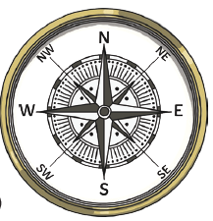


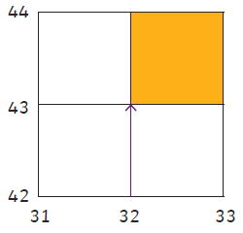
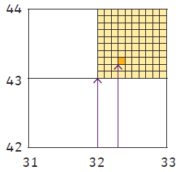
4 and 6 figure grid references
Year
What should I already know?
A compass can be a tool for showing the directions - North, South, East and West
A map is a 2D way of showing information and there are different types.
A key on a map explains what the symbols mean.
Key vocabulary and definitions
Cardinal Points | North, South, East and West
Ordinal Points | North-East, South-East, South-West, North-West
Ordnance Survey maps | A detailed map of Great Britain which shows physical and human features using symbols.
Physical Features | Natural features such as mountains, forests, deserts or lakes.
Human Features | Human made features such as buildings, roads and bridges.
Grid references | The numbered squares on a map used to locate a place.
Easting | Numbers used in a grid reference that run west to east
Northing | Numbers used in grid references that run south to north
Tenths | When something is divided into 10 equal parts
North N
North East NE
East E
South East SE
South S
South West SW
West W
North West NW
Symbols
Small pictures, letters or lines that represent a real- life feature.
footpath
place of worship
northings
eastings
Eastings and northings are put together to create a 4 figure grid reference, which refers to the bottom left corner of a square. e.g
(32, 43),
6 figure grid references are even more specific, they tell us where something is inside the square e.g (323 432)
These number are put together to create a 4 digit grid reference e.g (32, 43), which refers to the bottom left corner of a square.
Eastings are always identified and written first.
Remember the phrase: ‘Along the corridor and up the stairs’.

