Slide 1


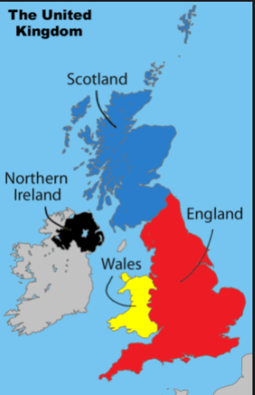
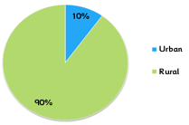
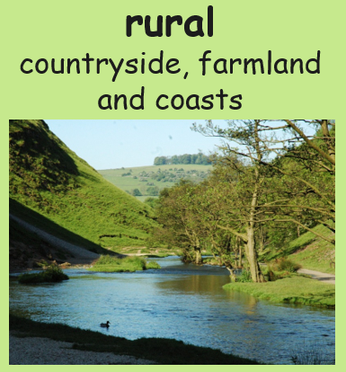
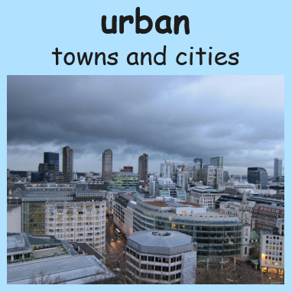
Land use and Settlements
Key vocabulary and definitions
What should I already know?
urban area | A place where lots of humans live with lots of building such houses, schools, shops and hospitals.
rural area | A place where not many people live, there are fewer homes or other buildings.
agriculture | Growing and harvesting of crops and raising livestock . It is another word for farming.
livestock farming | Breeding animals, such as cows, sheep, pigs or chickens for their meat or products.
arable farming | Land is used to grow crops such as wheat or vegetables in fields.
settlement | A place where people live and work.
transport | Different ways to travel e.g. car, lorry, aeroplane or train.
motorway | A road for fast moving traffic that links urban areas together.
populated | A place lived in by humans.
A location is a city, town or
village and if it is urban or rural.
Some human and physical features
of the UK and our local area.
That places can change over time.
When an area is being used for a specific purpose to meet the wants and needs of the people.
land use
How is land used in the UK?
Urban areas are more populated than rural areas.
This means more people live in towns and cities than in the countryside.
The UK can grow many things including: grass, grains
(e.g. wheat and corn) flowers, fruits and vegetables.
Cows, sheep, hens, pigs and goats can be raised too.

