Slide 1


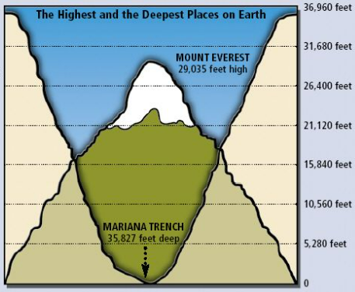
Marine Biomes
What should I already know?
That the Equator affects the worlds climates.
A biome has a specific climate and this affects the animals and plants that can live there – they have to adapt to survive.
Tectonic plates make up the Earth’s crust and are able to move.
Key vocabulary and definitions
ecosystem | A system of plants and animals that are interconnected and rely on each other
biome | An ecosystem that covers a large area.
marine biome | A large ecosystem in water
ocean | A vast body/area of salt water
coral reef | An underwater ecosystem made up of tiny animals called polyps.
estuary | The mouth of a river, where it meets the sea.
layers of the ocean | Sunlight zone, twilight zone, midnight zone, the abyss and the trenches
depth | How deep something is vertically
temperature | How hot or cold something is
Mariana Trench | A trench in the Pacific Ocean, the deepest place on earth.
The Mariana Trench:
Found in the Pacific Ocean (near China), within the ‘Ring of Fire’
The deepest part is called ‘Challenger Deep’ and it is almost 7 miles in depth.
Mount Everest can fit in side it!
ocean
Facts about Marine Biomes
It is the largest biome on earth and covers 75% of the planet
Oceans, coral reefs and estuaries are all saltwater environments.
5 oceans – Southern, Atlantic, Arctic, Indian and Pacific
Not all oceans are the same depth or have the same animals and plants living there.
Marine
biomes
coral reefs
estuaries

