Slide 1



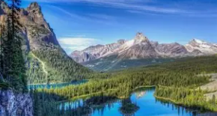
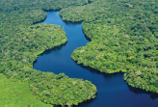
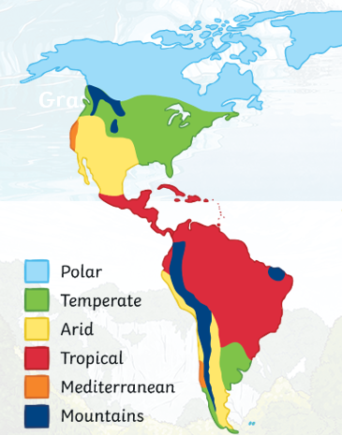
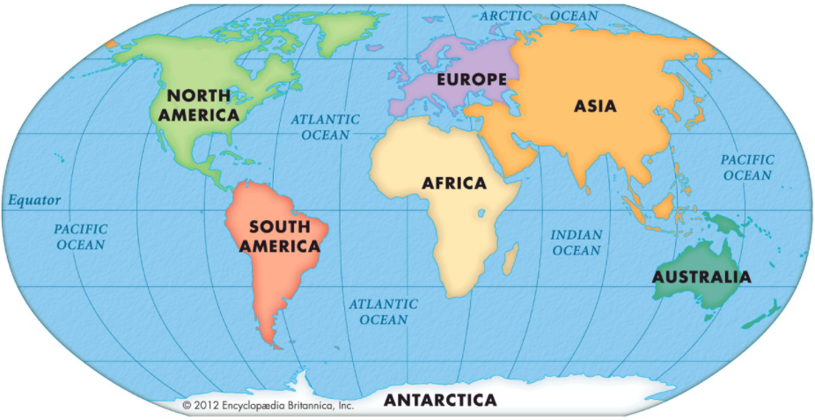
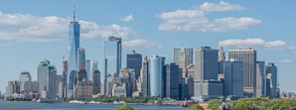
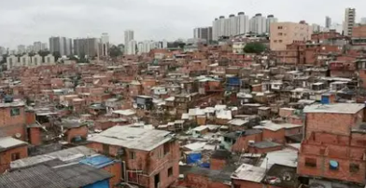
To compare and contrast the Americas
Year
What should I already know?
Weather changes daily and climate is the long term weather pattern of an area.
Latitude is how far north or south a place is from the Equator
Physical feature are natural e.g. mountains and forests.
Human features are created or influenced by humans e.g. roads or houses
Key vocabulary and definitions
The | The
 | A continent/landmass in the northern hemisphere, that includes the Caribbean Islands and Central America.
 | A continent/landmass mainly in the southern hemisphere.
Climate zones | Areas with different climates, determined by lines of latitude.
Tropics of Cancer and Capricorn | Lines that are north and south of the Equator, they define where the tropical region is on Earth.
Human activity | Things that people do or cause to happen.
Population density | The measurement of how many people live in an area
The Americas
The two continents of North and South America.
North America
South America
North America:
South America:
Climate zones of
the Americas
Physical feature Physical feature
The Rocky Mountains
Amazon River
Human features:
Northern hemisphere
Major cities are the most densely
populated areas in the Americas
The Americas
Equator
Southern hemisphere
New York
Sao Paulo

