Slide 1


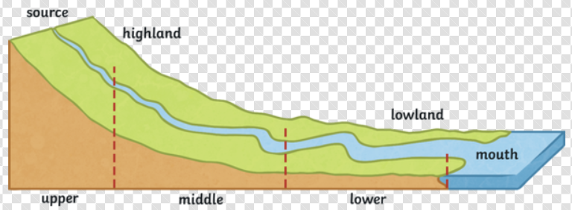
Rivers
Year
What should I already know?
What the water cycle is and how rivers are a part of it.
Rivers are moving bodies of water.
The names of some rivers in the UK.
Key vocabulary and definitions
source
mouth | Where a river meets a lake, larger river or the sea – the end of its journey.
brook | A small stream
stream | A small, narrow river.
tributary | A stream that flows into a larger stream or river.
spring | Where water comes up from underground to the surface of the Earth’s crust.
meander | A curve in a river, brook or stream.
deposition | When water drops or deposits any rocks or mud it is carrying.
estuary | Where a river meets the sea – freshwater and saltwater mix together.
erosion | The wearing away of rock or soil found along the river bank or bed.
Hydraulic erosion | The force of fast flowing water wears away the river bank from underneath.
source
The beginning of a river - a collection of rainwater or snow, a spring, bog or lake.
A river is freshwater flowing across the land.
The source of a river is usually on higher ground and as the water flows downwards, it gains more water from brooks, streams, rivers and waterfalls.
A river has three main areas: upper course, middle course and lower course.
meander
The Saffron Brook facts:
Its source is a spring, South East of Leicester City.
Before it enters Knighton Park, it is called The Wash Brook.
It flows through Knighton Park, into the grounds of Overdale Junior School and towards the city.
It is a tributary of the River Soar.

