Slide 1


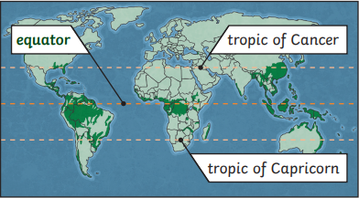
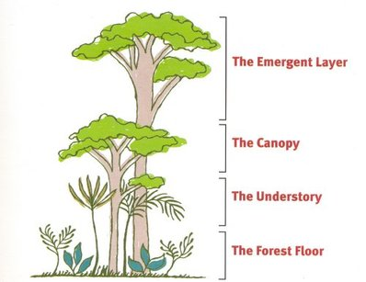
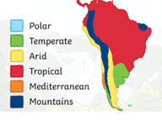
Year 5 The Rainforest Biome
Year
Key vocabulary and definitions
What should I already know?
Climate is the long term weather pattern in an area and South America has many different climates.
Latitude is how far north or south a place is from the Equator.
A habitat is the natural home of a plant, animal or other organism.
Amazon Rainforest
Located in South America, it is mostly contained in Brazil, Peru, Ecuador and Colombia. It is the largest rainforest in the world.
It produces 20% of the Earth’s oxygen
It is 5.5 million acres. The UK and Ireland could fit into it 17 times!
It is home to 40,000 plant species, 1,300 bird species, 3,000 types of fish, 430 mammals and 2.5 million different insects.
rainforest
Dense forest normally found in tropical areas with high rainfall.
vegetation belt
ecosystem | Plants and animals that are interconnected and rely on each other.
biome | An eco system that covers a large area.
South America | A continent or landmass found mainly in the southern hemisphere.
Tropic of Cancer and Capricorn | Lines that are north and south of the Equator, they define the tropical region.
Emergent | Tallest trees, direct sunlight and small animals live here e.g. birds or monkeys.
Canopy | Trees form a roof over the plants below, toucans, tree frogs and lizards live here.
Understory | Damp with little sunlight and short trees. Jaguars and beetles can live here.
Forest floor | Lowest layer, dark with lots of insects and larger animals e.g. anteaters and gorillas.
deforestation | Forests are cut down or cleared, so the land can be used for a different purpose.
endangered | At risk of disappearing forever, becoming extinct.
Areas that are home to certain plant species determined by the climate.
Amazon Rainforest
Largest tropical rainforest in the world, is located in South America, mostly in the country of Brazil.
It produces over 20% of the Earth’s oxygen.
It is the habitat of thousands of plants and animals.
Where are rainforests found?
Amazon
rainforest
Layers of the rainforest
South America’s climates
Emergent
Canopy
Understory
Tropical climate = warm to hot temperatures and lots of rainfall.
Forest Floor

