Slide 1


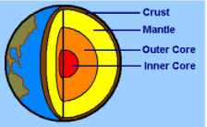
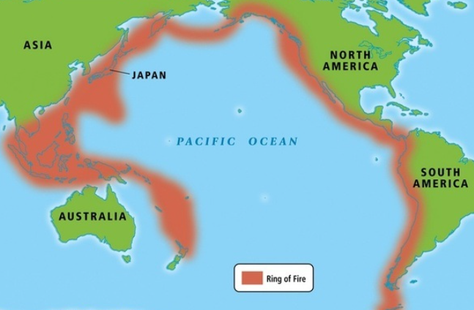
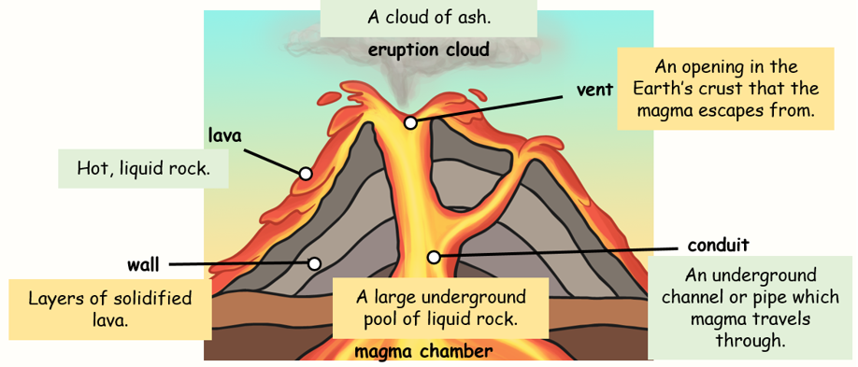
Year 3 Volcanoes and Earthquakes
Year
Key vocabulary and definitions
A sudden and terrible event in nature,
that can cause damage to people and places e.g. storms, volcanic eruptions and earthquakes.
What should I already know?
Physical features are made by nature e.g.
mountains and rivers.
The Earth has land and water on its surface.
Places can change over time.
Tectonic plates
Colliding | To crash into something
Pressure | Stress or strain
Volcano | An opening in the Earth’s crust that allows lava, ash and gases out.
Eruption | Explosion
Ash | The powder that is left after something has burnt.
Earthquake | The shaking of the Earth’s crust due to tectonic plates moving/colliding.
 | Measures how powerful an earthquake is, using numbers 1-10, 1 = weak 10 = very strong
Natural
disaster
Tectonic
plate
Large moving pieces of the Earth’s crust – they fit together like a jigsaw
mantel
Crust:
The hard outer layer made from rock.
Layers of the Earth
Outer Core:
Liquid metal
Mantle:
Hot, liquid rock called magma.
Inner Core:
Solid metal
Richter
Scale
T
The Ring of Fire
Around the edge of the Pacific Ocean, there are lots of volcanic eruptions and earthquakes.
Ring of Fire

